Slide 1

Real time operating system
Free RTOS & CMSIS RTOS V2
STM 32

Slide 2

4 types of real time operating system
01 – Hard Real time operating system
02 – Soft real time operating system
03 – Firm Real-time operating system
04 – Deterministic Real-time operating system

Slide 3
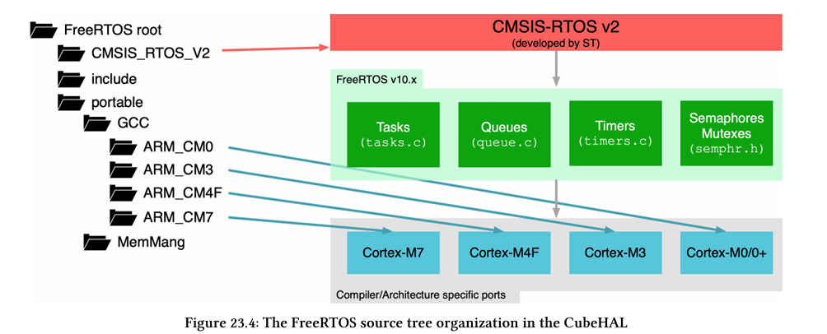

Slide 4
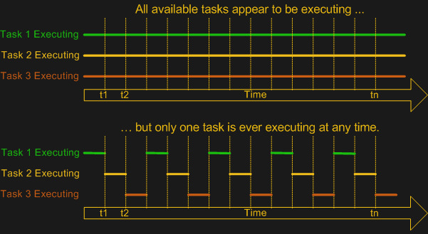

Slide 5
Thread Management
Thread States
Thread Priorities and Scheduling Policies
Voluntary Release of the Control
The idle thread

Slide 6
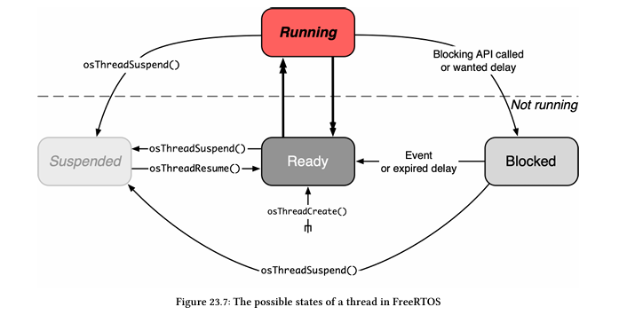

Slide 7
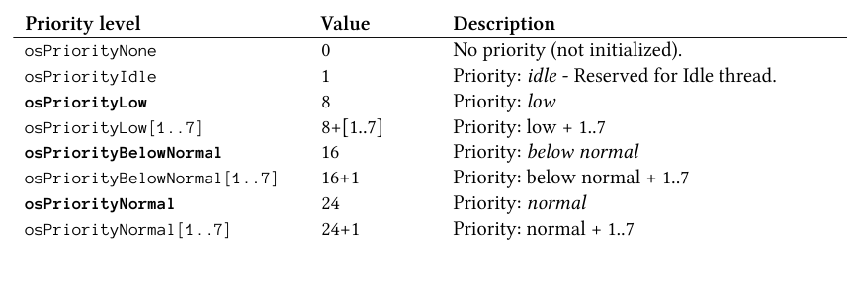
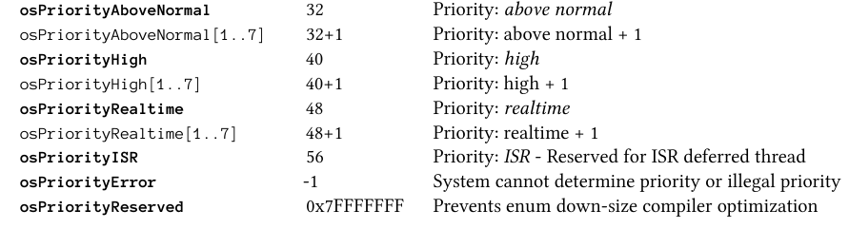

Slide 8
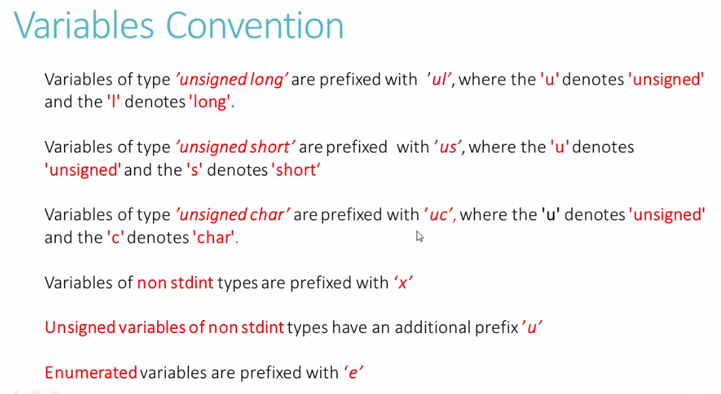

Slide 9
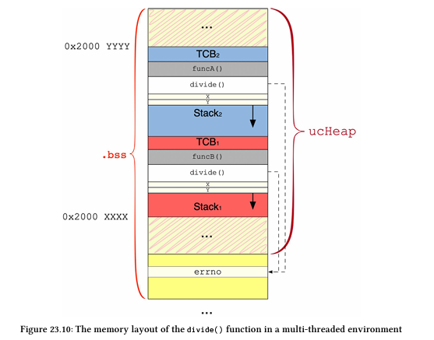

Slide 10
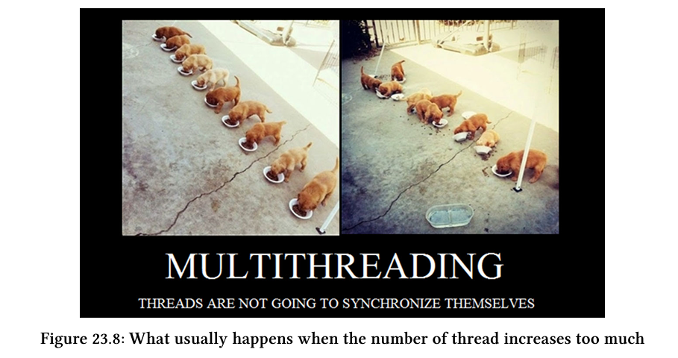

Slide 11
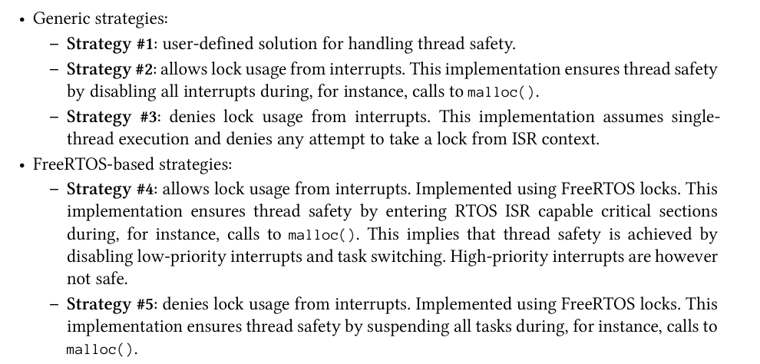

Slide 12
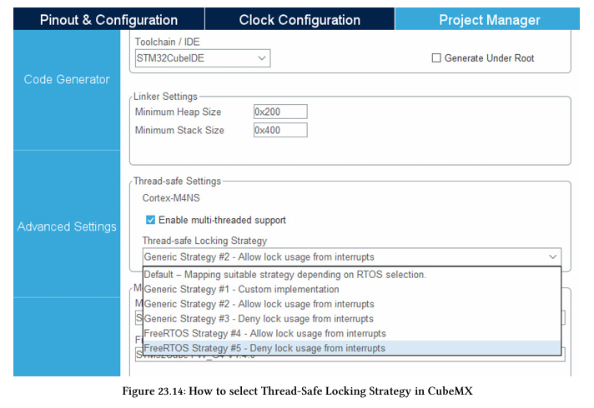

Slide 13
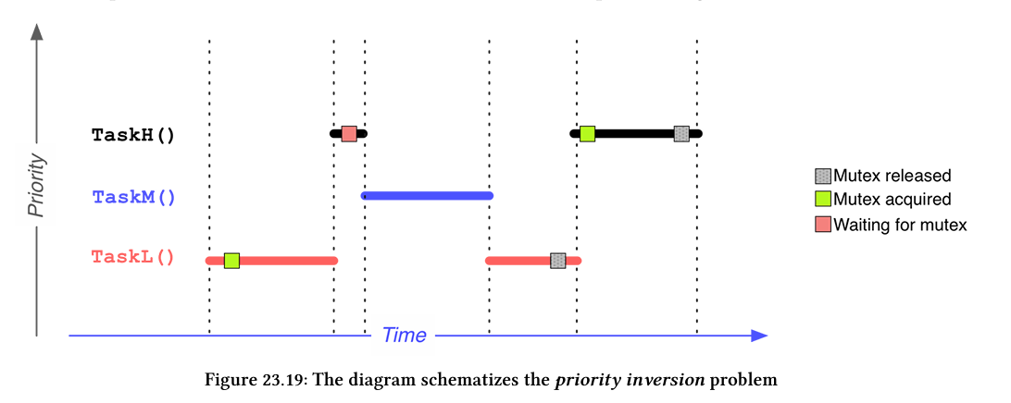

Slide 14
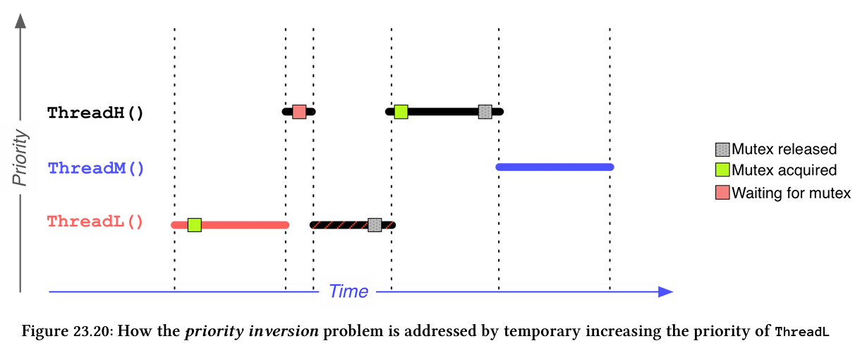

Slide 15
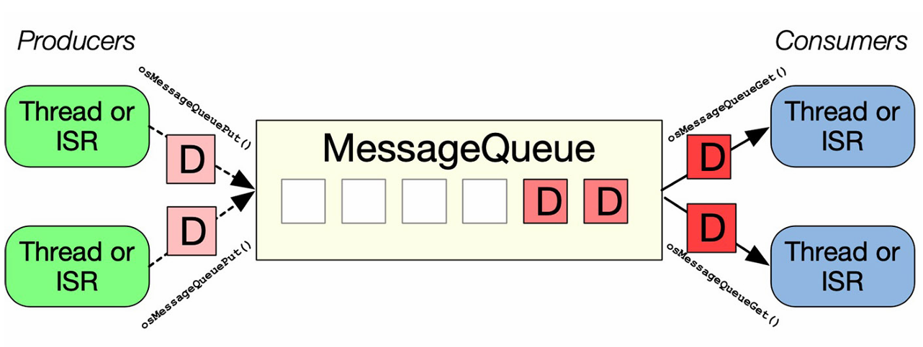

Slide 16
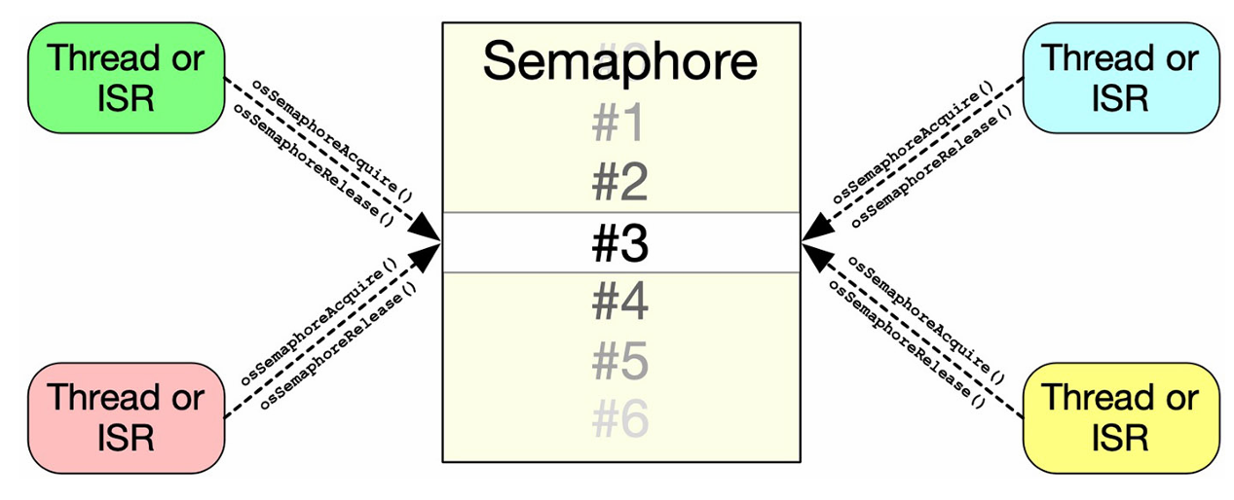

Slide 17

Memory Management in FREE RTOS

Slide 18
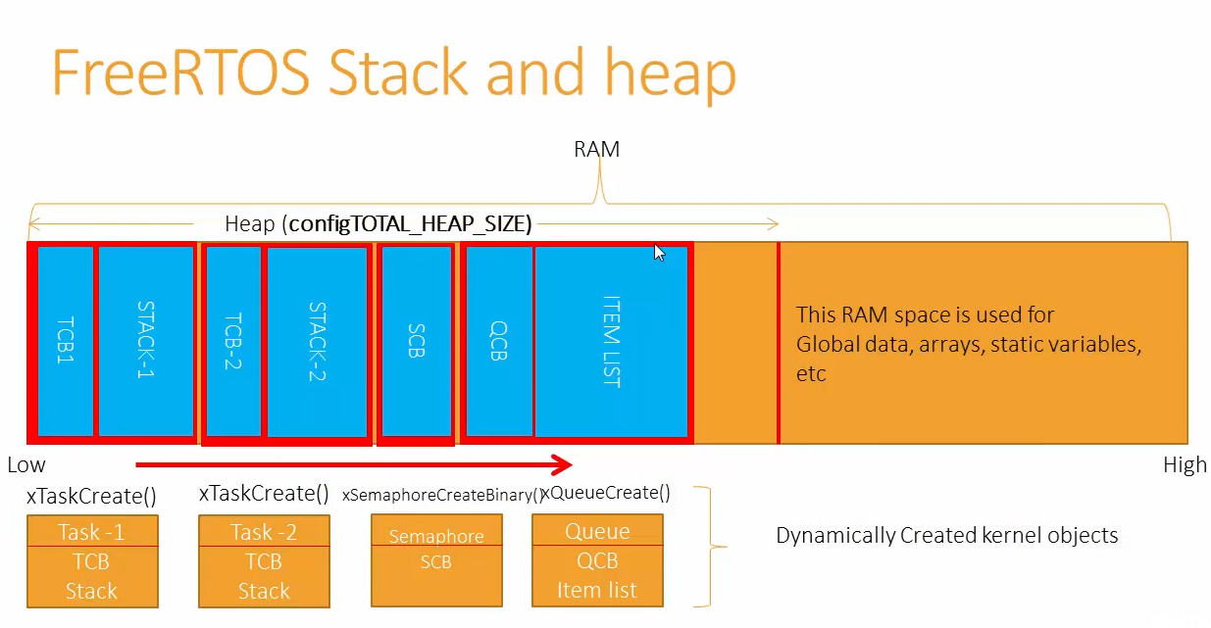

Slide 19
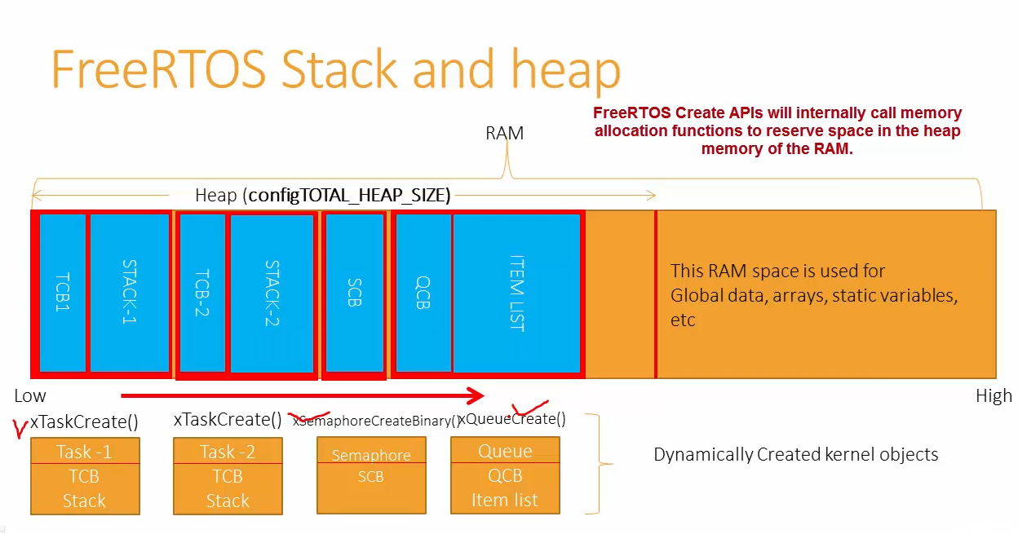

Slide 20
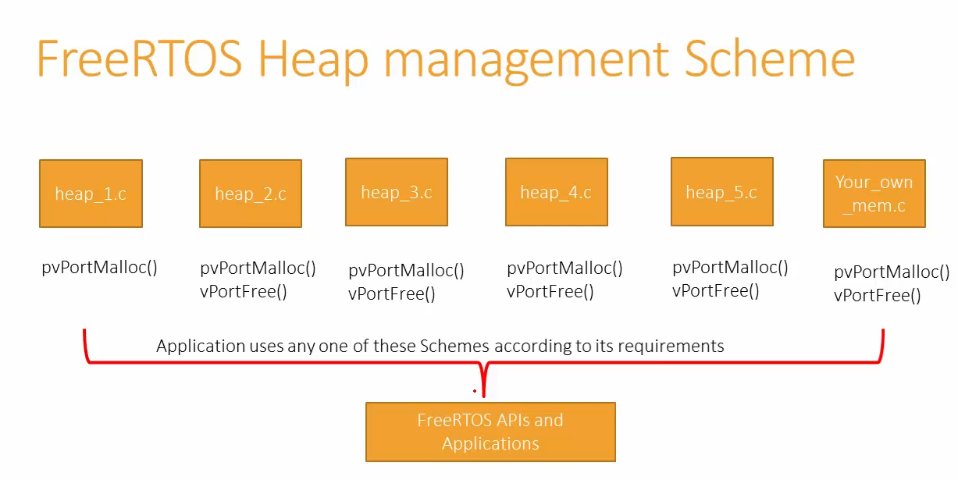

Slide 21
Heap 1.c Static Memory Allocation
Simplest Implementation among all other heap management implementations
In this implementation you can only allocate Heap memory but you can not free it.
Can be used if your application never deletes a task, queue, semaphore, mutex, etc. (Which actually covers the majority of applications in which Free RTOS gets used).
This implementation is always deterministic ( always takes the same amount of time to execute ) and cannot result in memory fragmentation.

Slide 22
Heap 2.c Simple Dynamic Allocation
Supports memory allocation and freeing (pvPortMalloc() and vPortFree()).
Simple applications that require some dynamic memory allocation.
Allocates and frees memory but does not handle fragmentation well.

Slide 23
Heap 3.c C Library Malloc/Free
The heap_3.c is not a freeRTOS customization to allocate and de allocate heap, it just a wrapper around the standard ‘C’ library functions like malloc and free.
Since this implementation uses malloc and free, the code size may shoot up, because malloc and free are not embedded system friendly in terms of code space consumption.
Also using malloc and free will undoubtedly kill the time deterministic nature of the real time application because malloc and free are indeed slow compared to other heap implementations.

Slide 24
Heap 4.c Best-fit Allocation with Coalescing
Provides allocation and free support with coalescing to avoid fragmentation.
Ideal for applications requiring flexible and dynamic memory allocation with a focus on efficient use of heap space.
Merges adjacent free blocks to reduce fragmentation.

Slide 25
Heap 5.c Multiple Regions Support
Allows memory allocation across multiple regions of memory.
You can define several memory regions, and FreeRTOS will allocate memory across these regions.
Useful when your system has non-contiguous blocks of memory.

Slide 26

Free RTOS allocation.
1) Dynamic allocation
2) Static allocation

Slide 27
Memory Management scheme
The RTOS kernel allocates RAM each time a task, queue, mutex, software timer or semaphore is created.
To replace and improve the use of C standard libray malloc() and free() functions, the FreeRTOS download includes four sample memory allocation implementations. The schemes are implemented in the heap_1.c, heap_2.c, heap_3.c, heap_4.c and heap5.c sources files respectively.
The schemes defined by heap_1.c, heap_2.c, heap_4.c and heap_5.c allocate memory from a statically allocated array, known as the FreeRTOS heap.
TOTAL_HEAP_SIZE sets the size of this array. The size is specified in bytes.

Slide 28
Memory Management scheme
Both allocations required with current CMSIS-RTOS V2 files
In CubeMx, setting MEMORY_ALLOCATION allows to configure configSUPPORT_STATIC_ALLOCATION and configSUPPORT_DYNAMIC_ALLOCATION parameters at the same time:
- when equals to "Dynamic", sets configSUPPORT_DYNAMIC_ALLOCATION to 1 and configSUPPORT_STATIC_ALLOCATION to 0 - when equals to "Static", sets configSUPPORT_DYNAMIC_ALLOCATION to 0 and configSUPPORT_STATIC_ALLOCATION to 1 - when equals to "Dynamic / Static", sets both configSUPPORT_DYNAMIC_ALLOCATION and configSUPPORT_STATIC_ALLOCATION

Slide 29
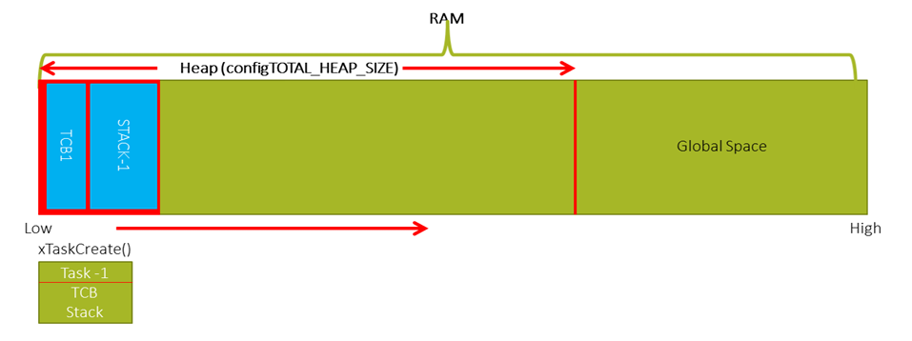
Dynamic Memory Allocation From Heap

Slide 30
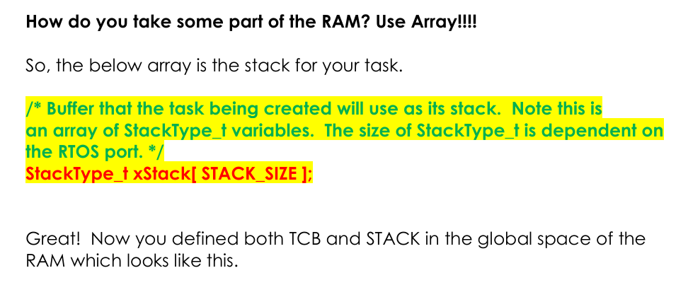
Static Memory Allocation From Global Space (outside of heap)

Slide 31
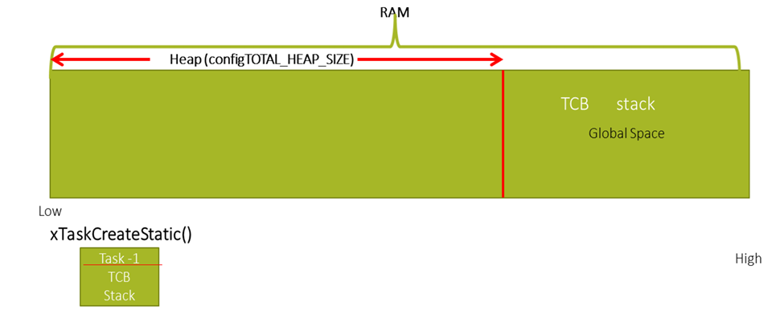
Static Memory Allocation From Global Space (outside of heap)

Slide 32
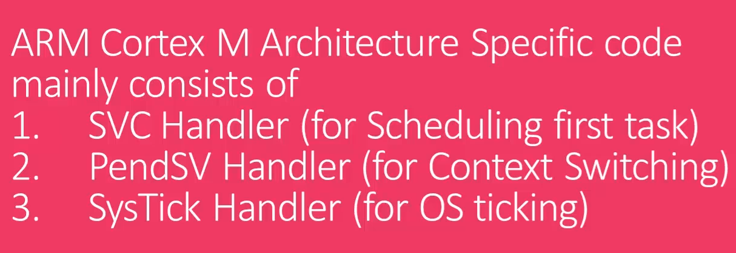

Slide 33
Pend SV Handler

Slide 34
PendSV Exception
In OS Designs, we need to switch between different tasks to support multitasking. This is typically called context switching.
Context switching is usually carried out inside the PendSV exception handler.
It is exception type 14, mean exception number and has a programmable priority level.
possible can set to lowest priority.
This exception is triggered by setting its pending status by writing to the "Interrupt Control and State Register".

Slide 35
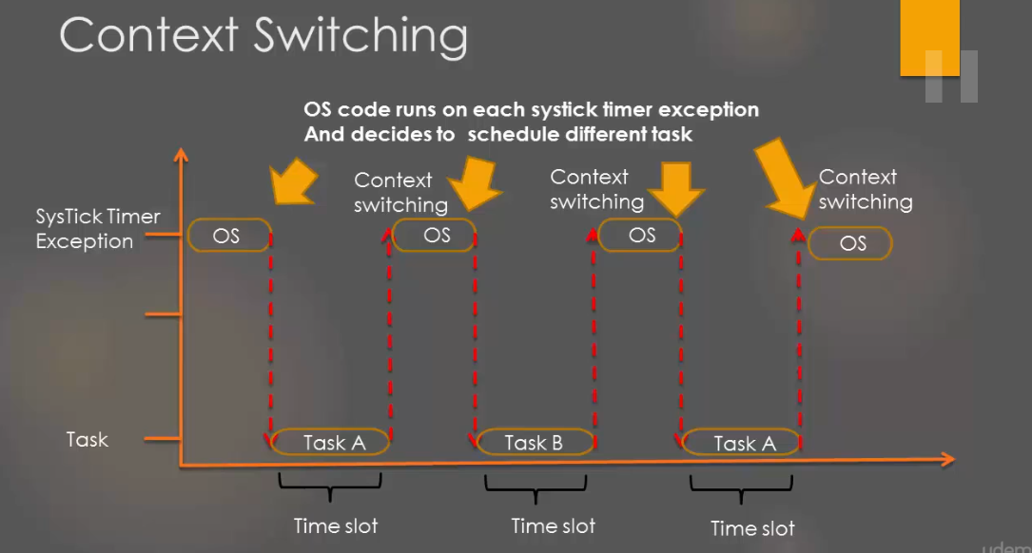

Slide 36
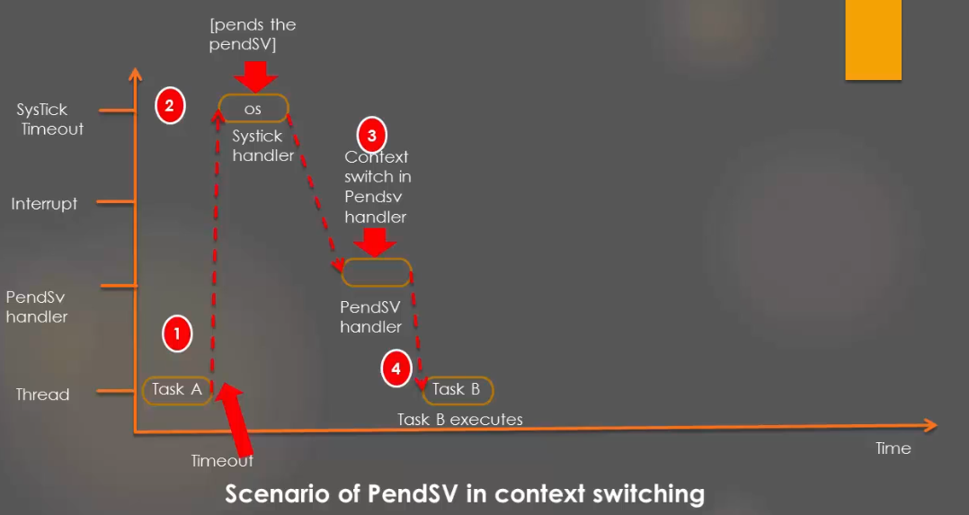

Slide 37
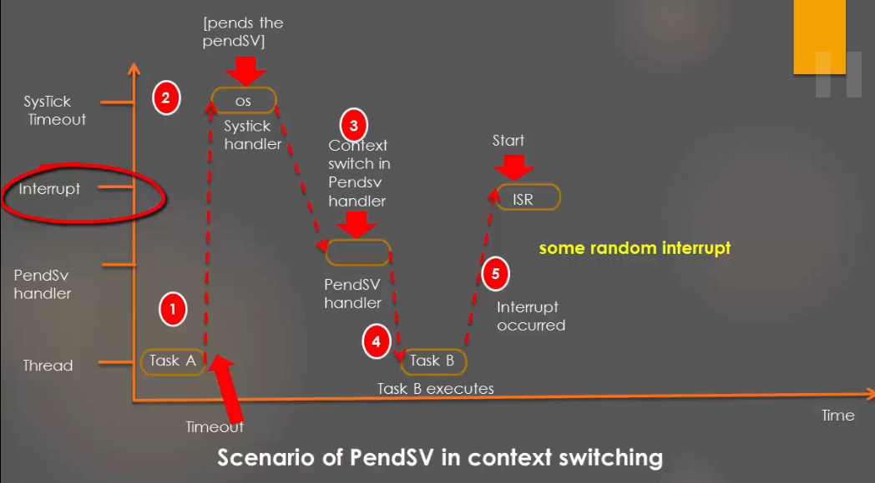

Slide 38
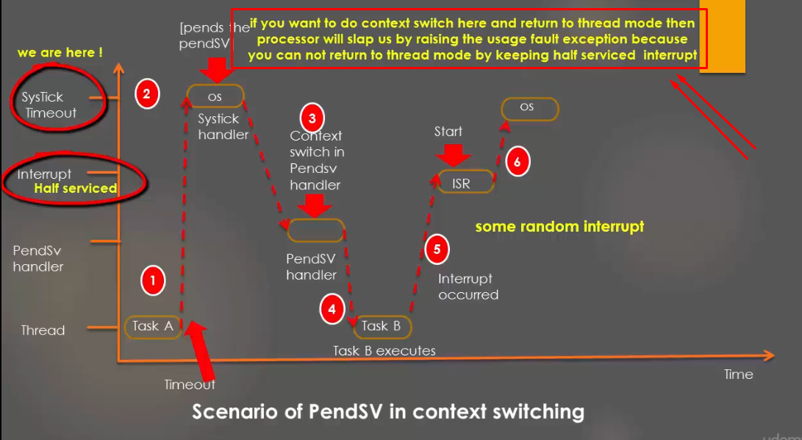

Slide 39
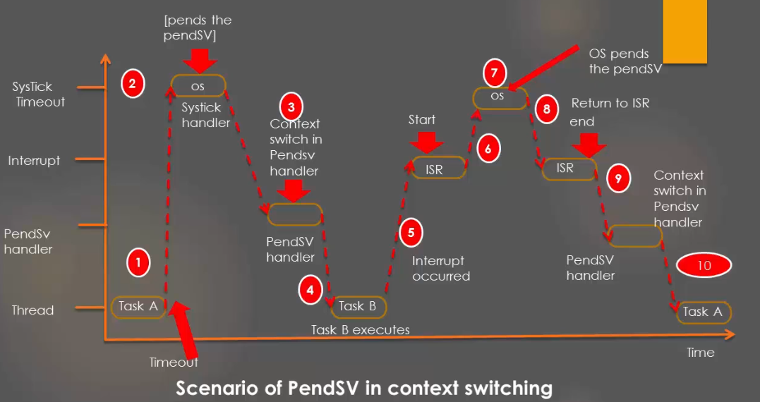

Slide 40
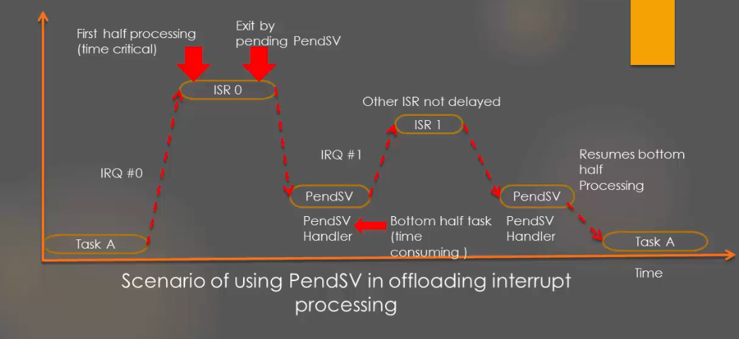

Slide 41
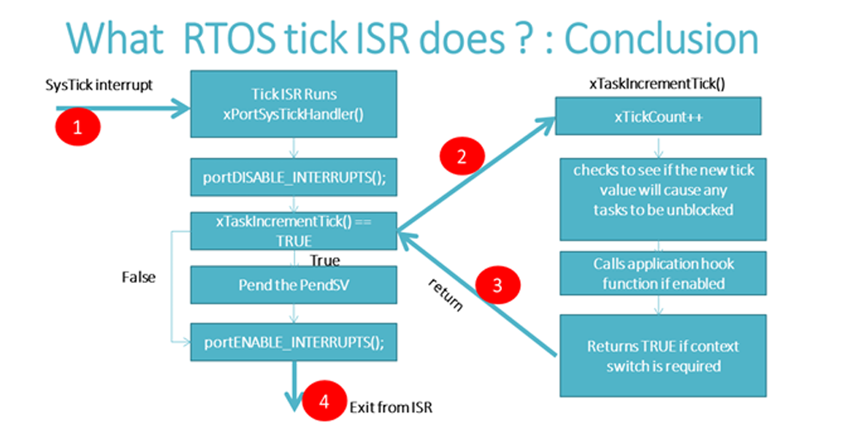

Slide 42
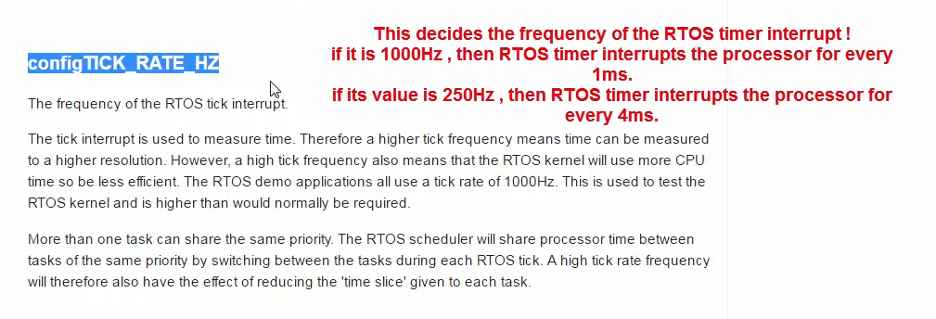

Slide 43
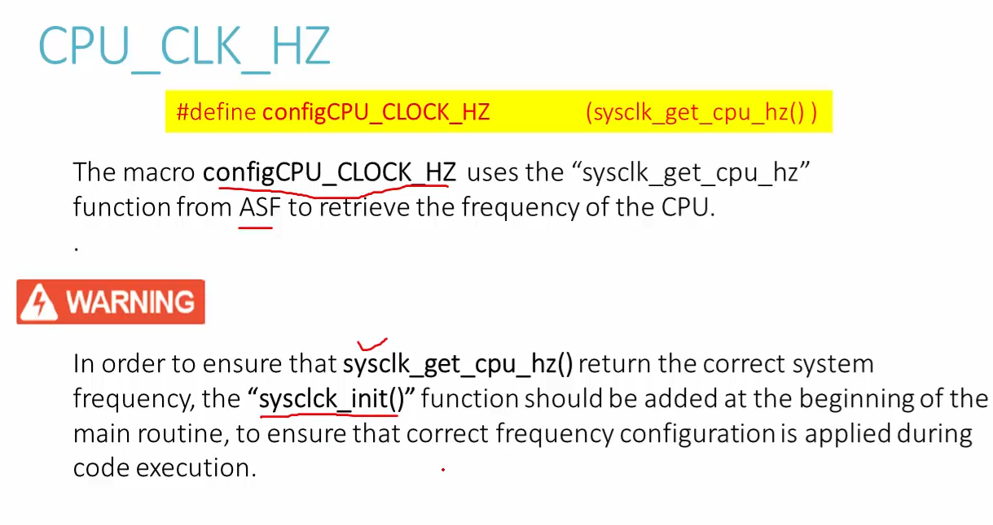

Slide 44
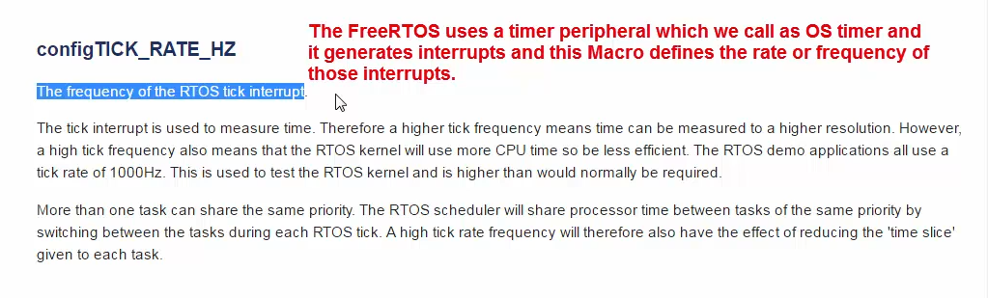
Tick interrupt happen every 1 ms in 1000 Hz
Tick interrupt happen every 4 ms in 250 Hz

Slide 45
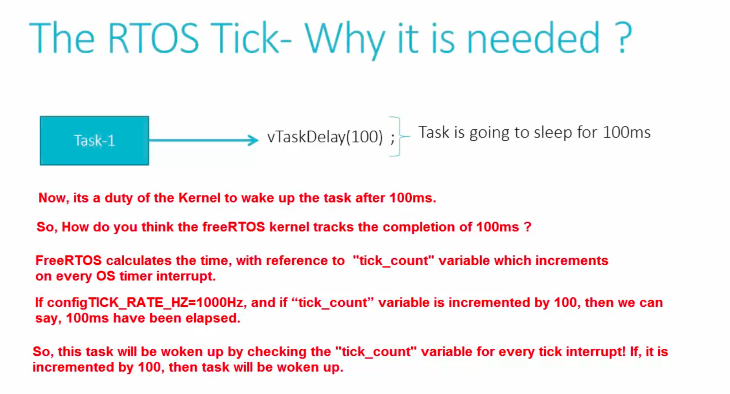

Slide 46
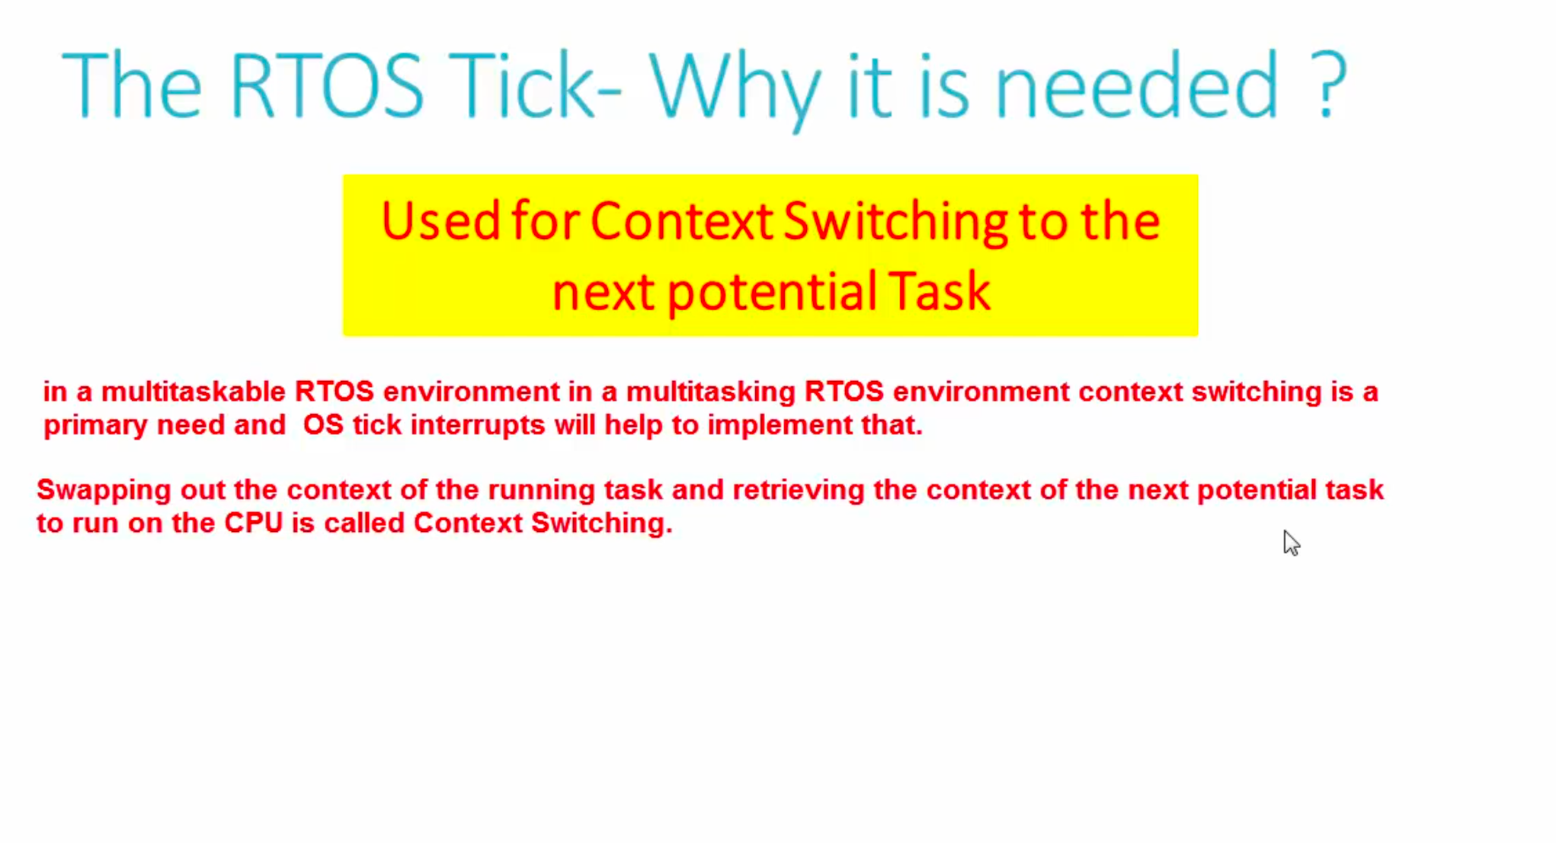

Slide 47
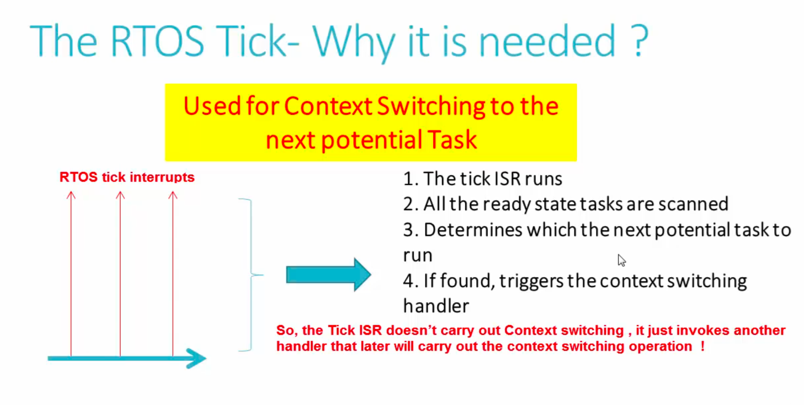
Kernel will be use hardware timer peripherals to issues ticks

Slide 48
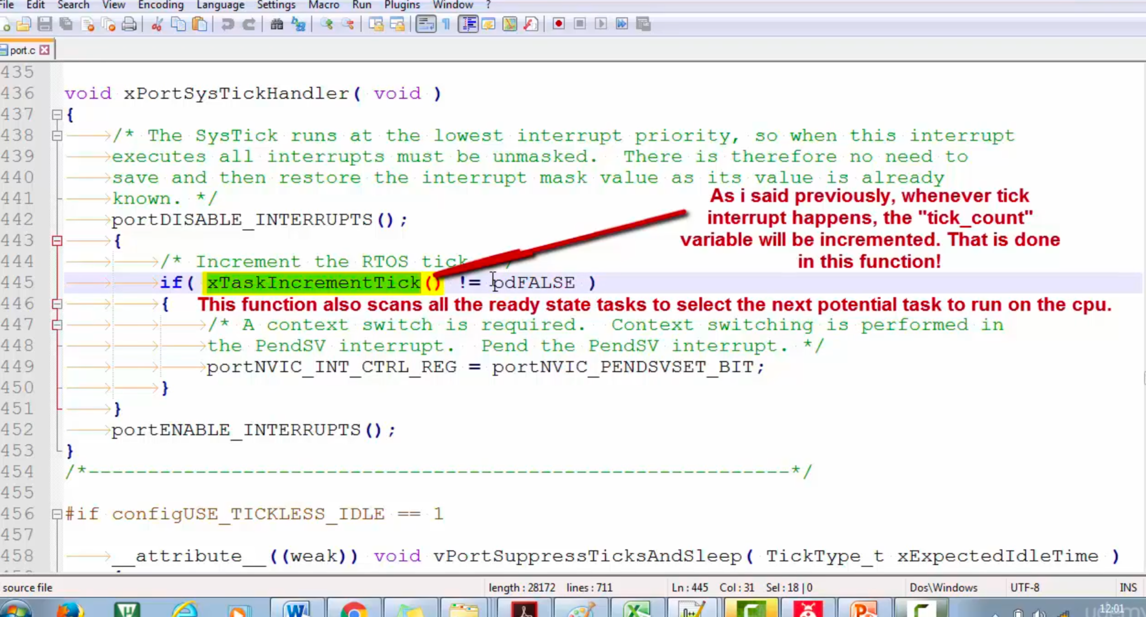

Slide 49
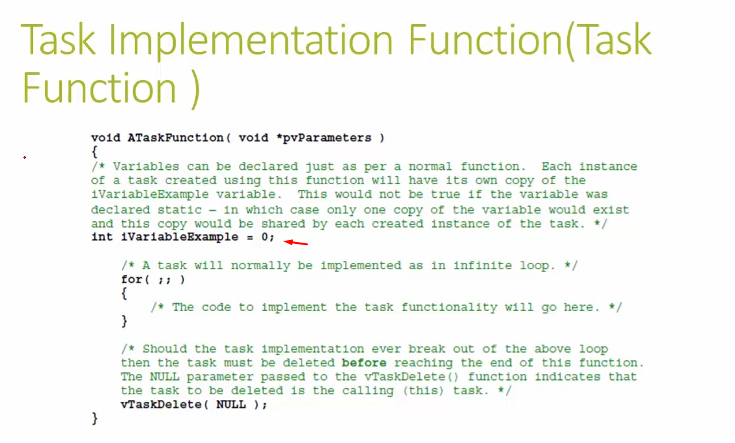
vTaskDelete() က task တစ်ခုဒီ function ကိုလာသုံးပြီးတာနဲ့ တန်းပြီး ဖျက်မှာ။
ဥပမာ - task2 ခုက ဒီ function handlerကို ဘုံသုံးမယ်ဆိုရင် int နဲ့ ကြေညာထားတဲ့ iVariableExample သည် task တစ်ခုခြင်းစီအတွက် local var အဖြစ် Task ရဲ့ stack memory ထဲမှာသိမ်းမှာဖြစ်တယ်။
Int ကို static အဖြစ်နဲ့ ကြေညာလိုက်ရင်တော့ global shared variable အဖြစ်နဲ့ task နှစ်ခုက အပြိုင်သုံးမှာဖြစ်တယ်။

Slide 50
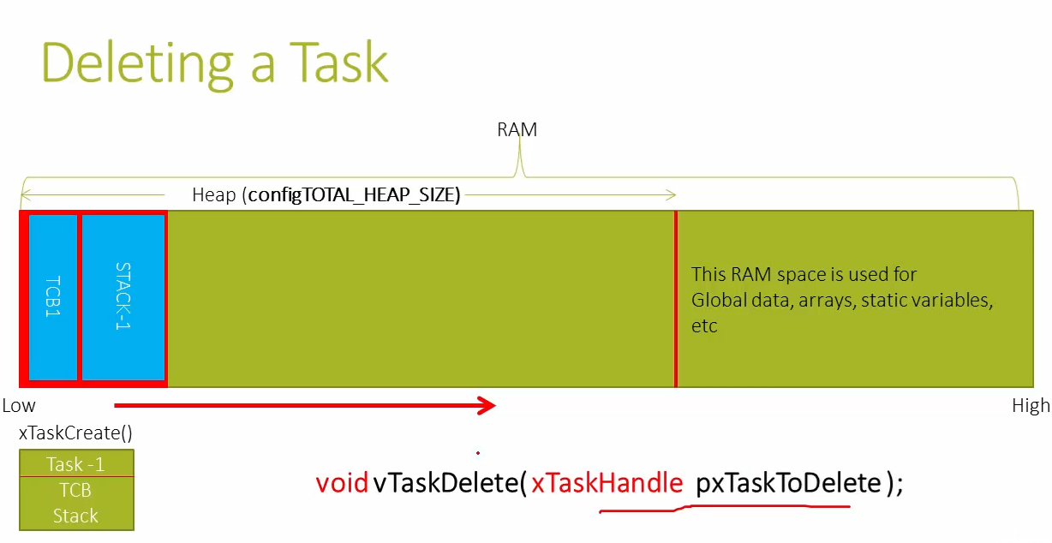
Task ကို delete လုပ်တာဟာ memory ပေါ်က TCB နဲ့ Stack memory တို့ကို deallocate လုပ်ပေးခြင်းမဟုတ်ပါ။
Task ကို delete လုပ်ထားကြောင်း declare လုပ်ပေးရုံသာဖြစ်တယ်။
Rtos system ၉၀ % သုံးသော task များသည် delete လုပ်ရန်မလိုအပ်ပါ။
ထို့ကြောင့် task တစ်ခုကို မ run စေချင်ရင် blocked state (or) suspended state ထားရန်အကြံပေး။

Slide 51
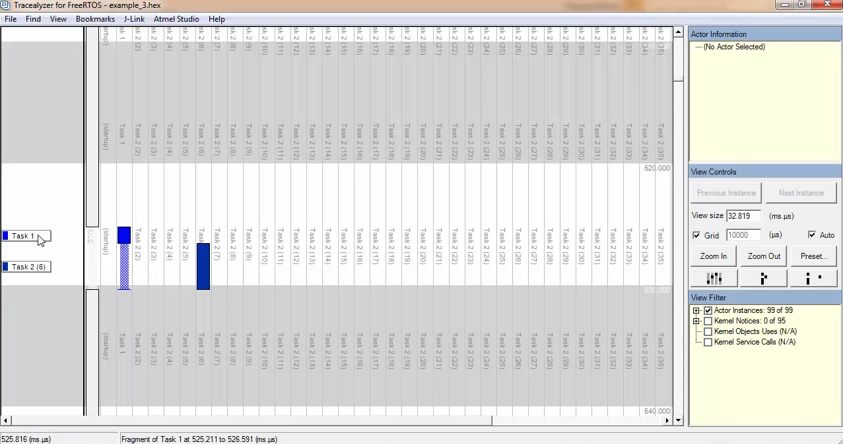

Slide 52
Priority register and priority levels in ARM Cortex-M Processor

Slide 53
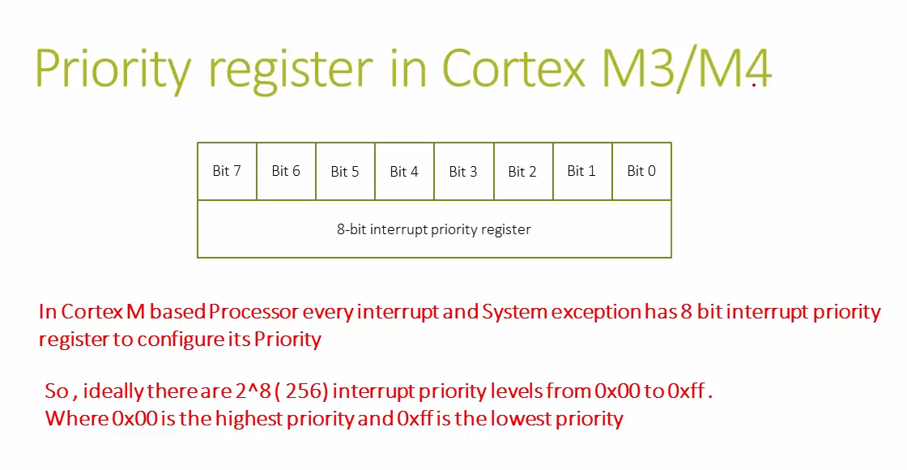

Slide 54
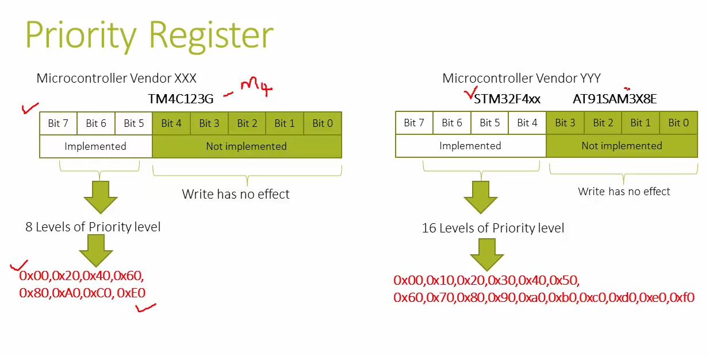

Slide 55
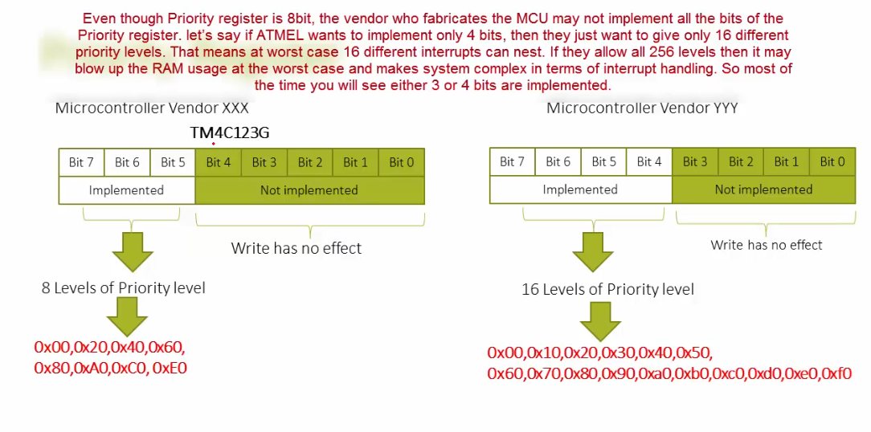

Slide 56
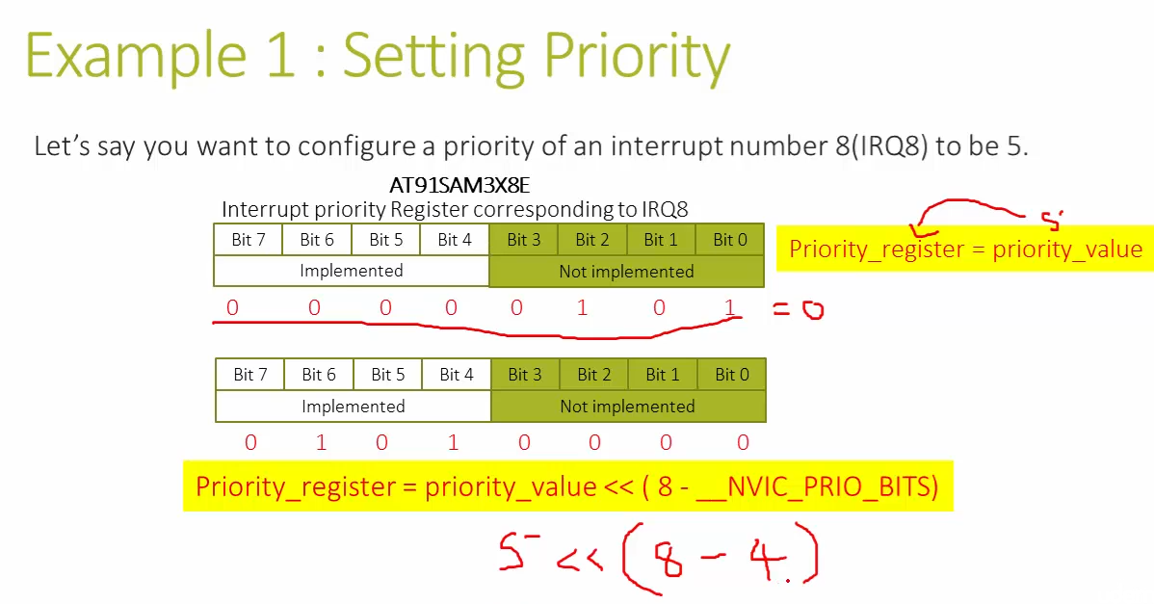

Slide 57
FreeRTOS Task Priority Vs Processor Interrupt/Exception Priority

Slide 58
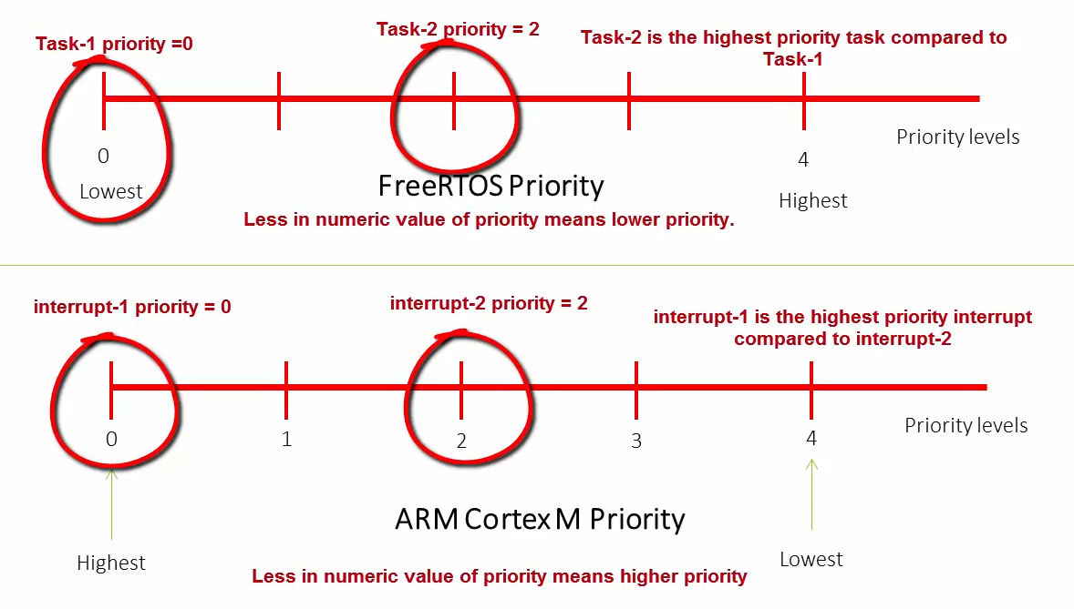

Slide 59
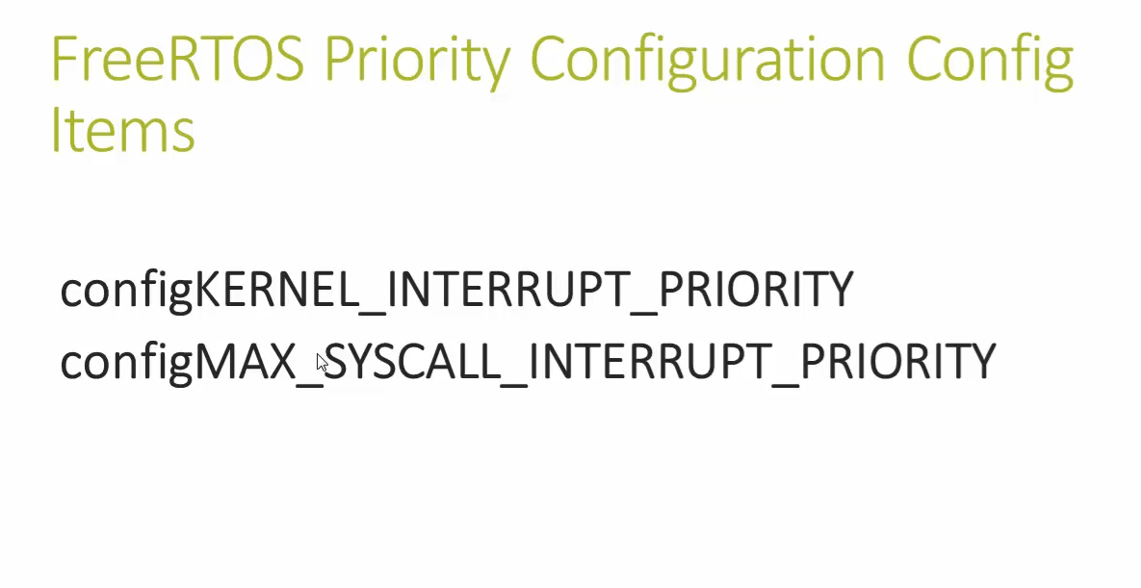

Slide 60
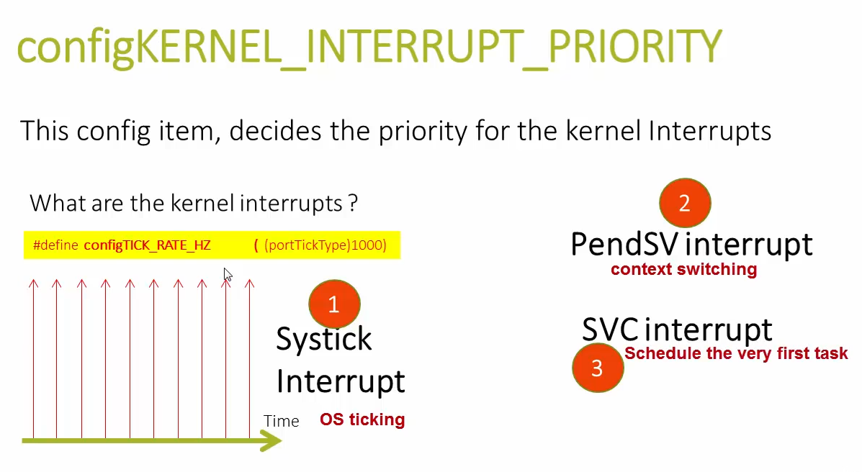

Slide 61
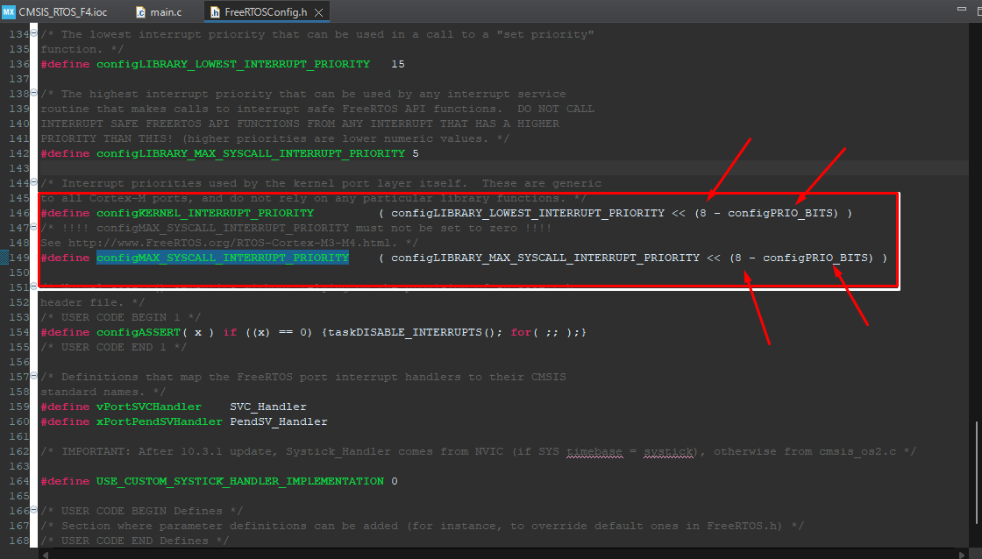

Slide 62
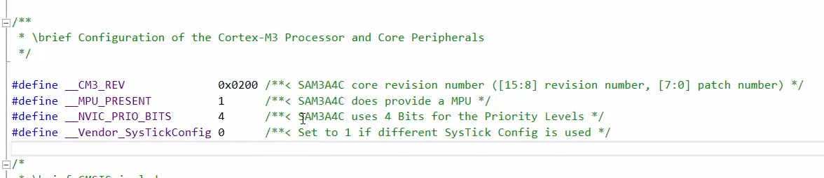
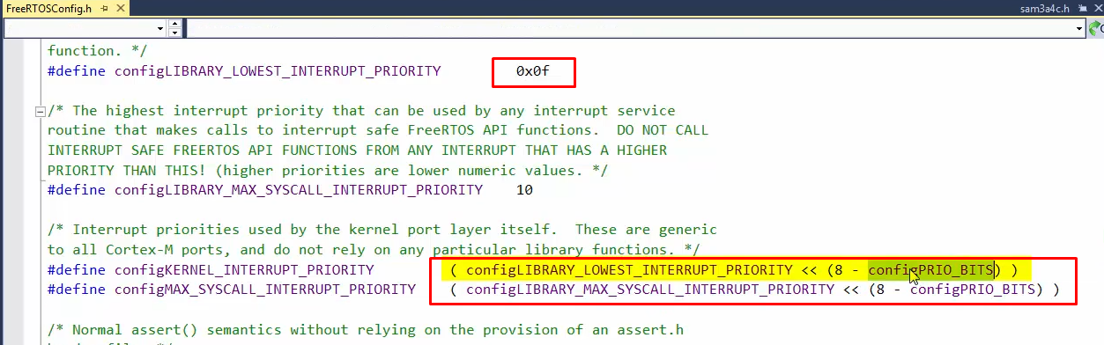

Slide 63
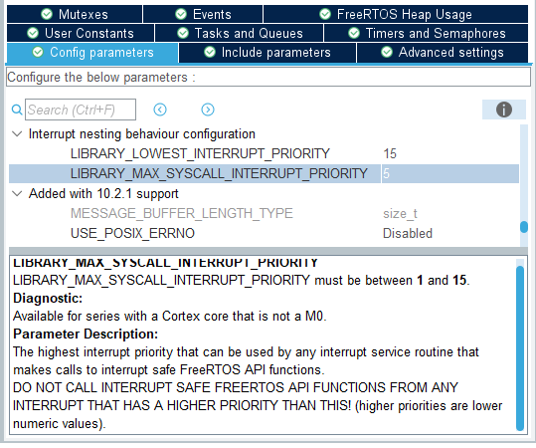

Slide 64
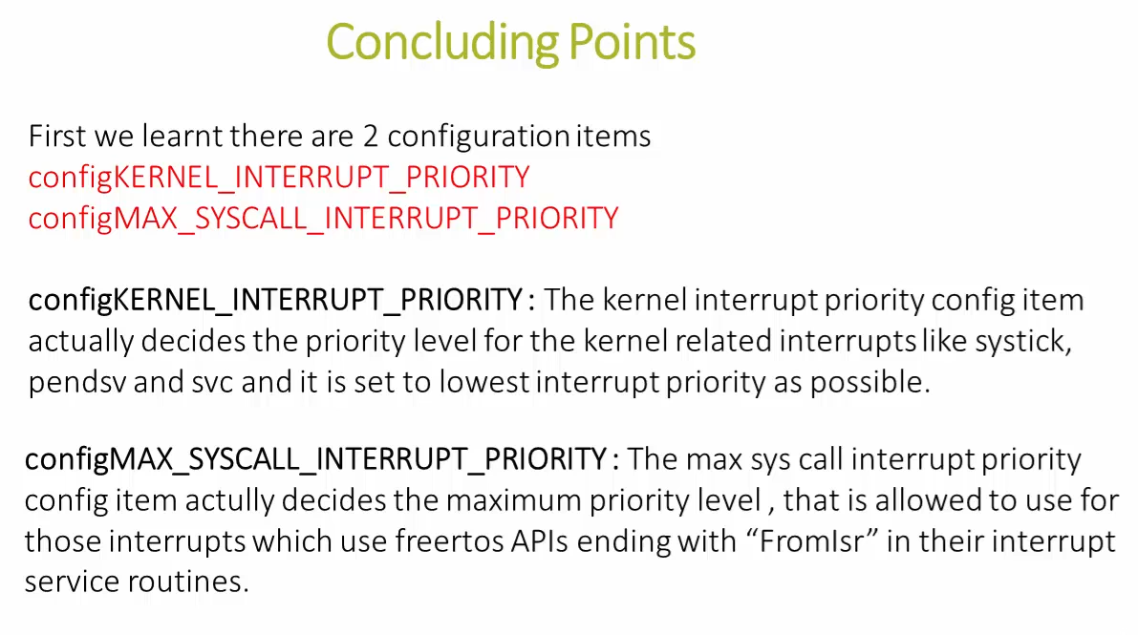

Slide 65


Slide 66


Slide 67


Slide 68


Slide 69


Slide 70


Slide 71



Slide 72


Slide 73


Slide 74


Slide 75


Slide 76


Slide 77


Slide 78


Slide 79

Requirement was to wake up the task up at fixed timings, but we missed that, our task wakes up at + 50 ms

Slide 80

ဒီ api func လေးကတော့ PreviousWakeTime ကို ပြန်ယူထားပီး လိုအပ်တဲ့ အချိန်ကို ပြန်ပီးတိုးပေးမှာဖြစ်တဲ့အတွက် task တစ်ခုအတွက် delay အတိအကျကိုရရှိနိုင်မှာဖြစ်ပါတယ်။

Slide 81
Convert time to ticks
Kernel က time ကိုနားမလည်တဲ့အတွက် ထည့်လိုက်တဲ့ time ကို tick ပြန်တွက်ပါတယ်။
configTICK_RATE_HZ = 1000 Hz သည် kernel အတွက်ဖြစ်ပါတယ်။ 1000 Tick interrupt မှာ 1 sec နဲ့ညှီမျှပါတယ်။
TICK_RATE_MS = 1/1000 = 1ms
အာ့အတွက် 2 ticks အင်တာရပ် နှစ်ခုကြားမှာ 1 ms ကြာမှာပါ။
အုပမာ - 250 Hz ကို သတ်မှတ်ထားမယ်ဆွင် 1/250 = 4 ms ကြာမှာပါ။

Slide 82


Slide 83

အရှေ့ကပုံရဲ့ရှင်းပြချက်
Task 2 က priority ပိုမြင့်တဲ့အတွက် အရင်ဆုံး run ပါတယ်။
Common function တစ်ခုထဲကို Task 1 ကပါ ထပ် run ပါမယ်။
Common func မှာ delay သုံးထားတဲ့အတွက် task နှစ်ခုလုံး run ပြီးသွားတာနဲ့ idle state ကြီး ဝင်သွားမှာဖြစ်တယ်။

Slide 84


